Slide 1

Multiplex booking System Using spring unit
Guided By:
Nandini
Project by:
1.Alekhya Barla
2.Akhila Mangali
3.Alekhya Sana
4.Pranathi Kuppili
5.Yamini Gudapati

Slide 2
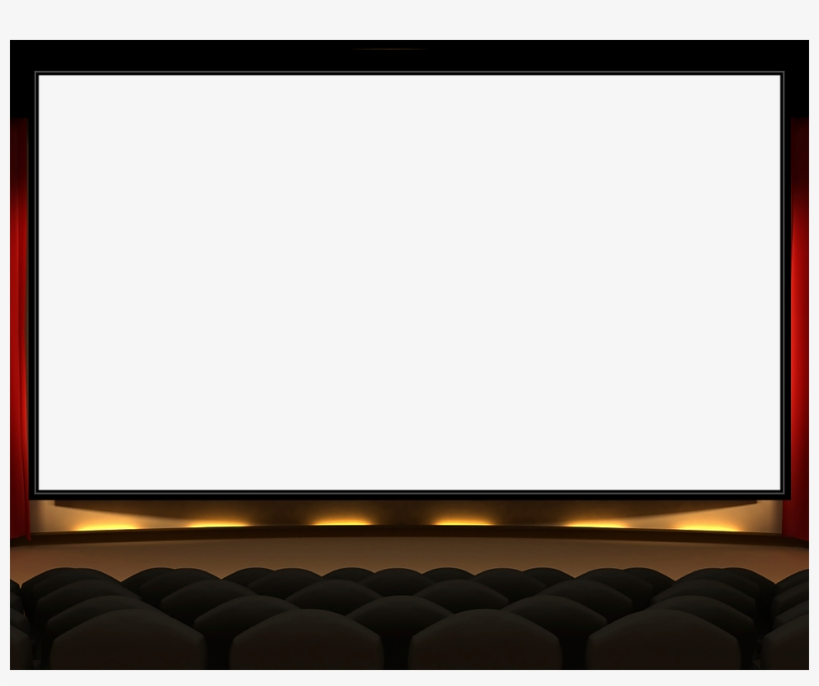
Contents
Problem Statement
Tables
Entities
Services
ServiceImplementation
Controllers
Exception
Swagger
Implementation

Slide 3
Problem Statement
A multiplex is a movie theatre complex having multiple screens to screen the movies. Many movies can run on these screens simultaneously during various time slots of a day.
The business requirement can be decomposed into:
1.User registration
2.Address the queries pertaining to Shows/Movies/User/Booking
3.Making Booking
4.Modify
Which are based on Basic CRUD Operations
The annotations that are used for the Spring Boot Project are
1.GetMapping 4.DeleteMapping
2.PostMapping 5.RequestMapping
3.PutMapping

Slide 4
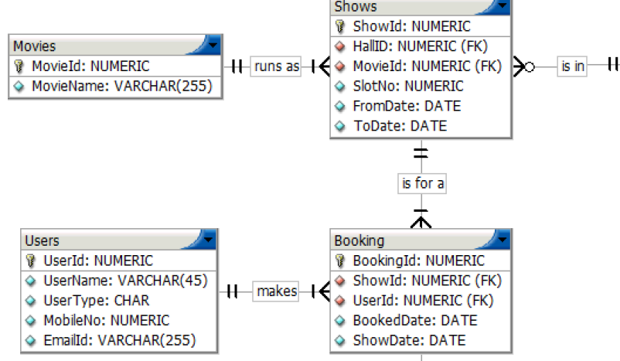
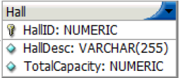
Case Diagram

Slide 5
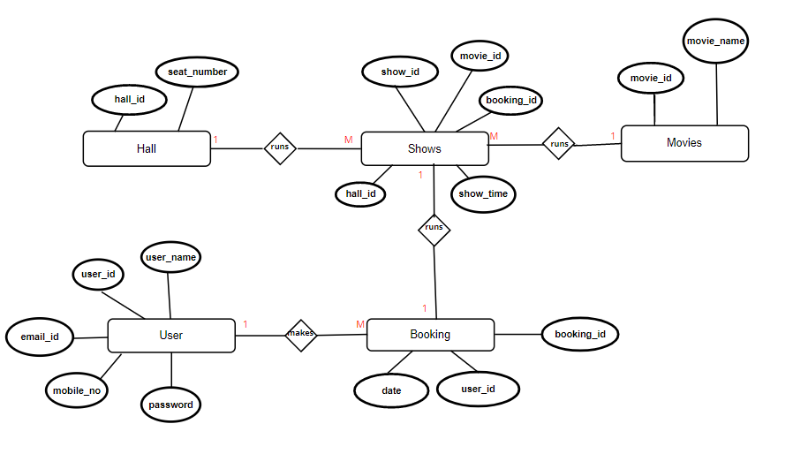
ER Diagram

Slide 6
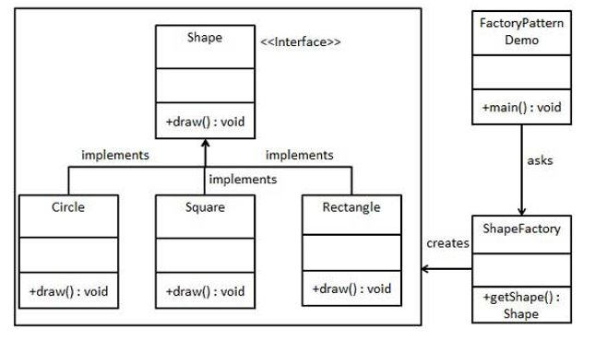
Service Layered Architecture
Factory pattern is one of the most used design patterns in Java. This type of design pattern comes under creational pattern as this pattern provides one of the best ways to create an object.
In Factory pattern, we create object without exposing the creation logic to the client and refer to newly created object using a common interface.
Step 1
Create an interface.
Step 2
Create concrete classes implementing the same interface.
Step 3
Create a Factory to generate object of concrete class based on given information.
Step 4
Use the Factory to get object of concrete class by passing an information such as type.

Slide 7
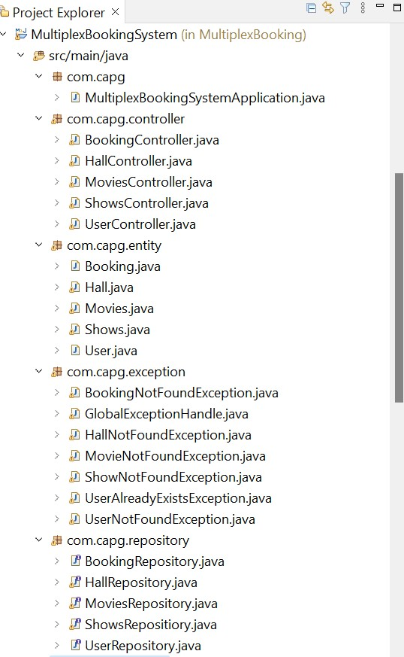
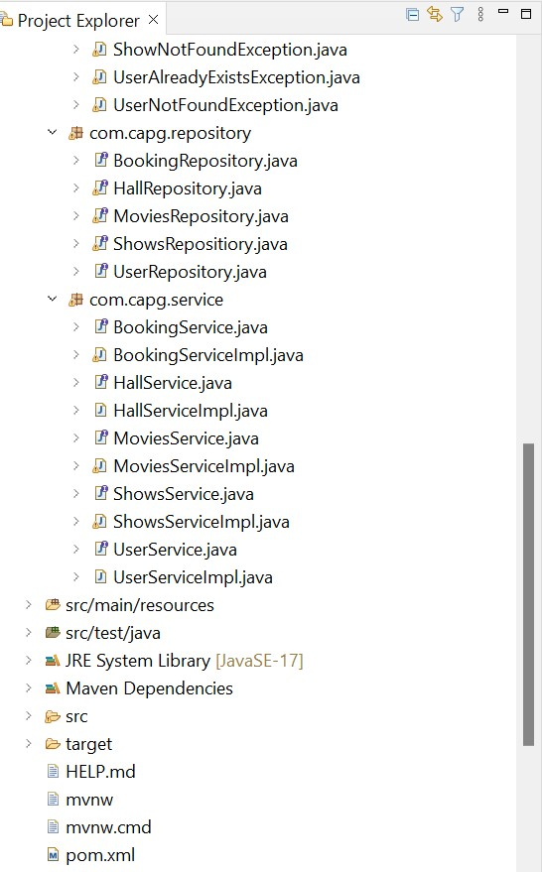
Project Structure

Slide 8
POM
The full form of POM is Project Object Model.
It is a fundamental unit of work in Maven
pom is a XML file that contains information about the project and
configuration details used by Maven to build the project.
When executing a task or goal, Maven looks for the POM in the current
directory. It reads the POM,gets the needed configuration information,
then executes the goal.
Configurations specified in the POM are the project dependencies,
the plugins or goals that can be executed, the build profiles.

Slide 9
Entities
The entities are the persistence objects stores as a record in the database. Persistence Unit: It defines a set of all entity classes. In an application, EntityManager instances manage it. The set of entity classes represents the data contained within a single data store.
@Entity annotation defines that a class can be mapped to a table. And that is it, it is just a marker, like for example Serializable interface.
POJO’S
1.User
2.Booking
3.Movies
4.Shows
5.Hall

Slide 10
Attributes
User -userId*,userName,emailId,mobileNo,password.
Booking -bookingId*,date,userId.
Movies -movieId*,movieName.
Shows -showId*,bookingId,showTime,hallId,movieId.
Hall -hallId*,seatNumber.

Slide 11
Services
DAO- It stands for Data Access Object
Spring boot service component is defined as a class file that includes the @Service annotation and allows developers to add business functionalities.
Our service package consists of the following interfaces:
BookingService
MovieService
ShowsService
UserService
HallService

Slide 12
ServiceImplementation
Service Layer implementation helps in keeping services separate
from controller and persistence layer.
Our serviceImpl package contains following services:
BookingServiceImpl
MovieServiceImpl
ShowsServiceImpl
UserServiceImpl
HallServiceImpl

Slide 13


Slide 14
Exceptions
Exception Handling in Spring Boot helps to deal with errors and exceptions present in APIs so as to deliver a robust enterprise application. This article covers various ways in which exceptions can be handled in a Spring Boot Project. Let’s do the initial setup to explore each approach in more depth.
Created separate classes for handling exceptions.
Separated the exception handling code from the business logic code.
BookingNotFoundException
GlobalExceptionHandle
HallNotFoundException
MovieNotFoundException
ShowNotFoundException
UserAlreadyExists Exception
UserNotFoundException.

Slide 15


Slide 16

Thank You

